Slide 1


Lego Robot
Challenge

Slide 2
Lego Robot Challenge
So today we're going to use a very friendly platform to start introducing you to computational thinking and some of the concepts around programming. Namely;
Sequencing – How programs execute and why the order is important
Branching – Simple if and switch statements
Looping – Repeat and while statements
Debugging – how to dry run a program in your head so that you can figure out what’s going wrong

Slide 3
Lego Robot Challenge
Use an unknown platform, an unknown language, and unknown hardware to complete a set of challenges.
Learn through play (investigation, experimentation, trial & error)
Surprise yourself – by the end of this session you will have programmed a self driving car!

Slide 4
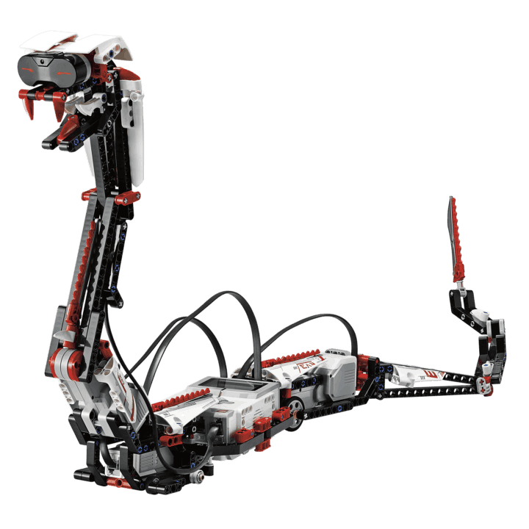
Lego Robot Challenge
The Rules
Asimov’s Three Laws of Robotics
Don’t harm humans
Obey orders
Protect yourself

Slide 5
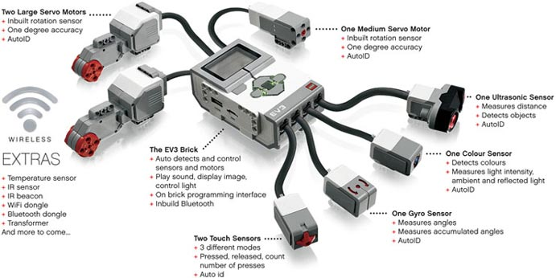
Lego Robot Challenge
The Lego Mindstorms Platform

Slide 6
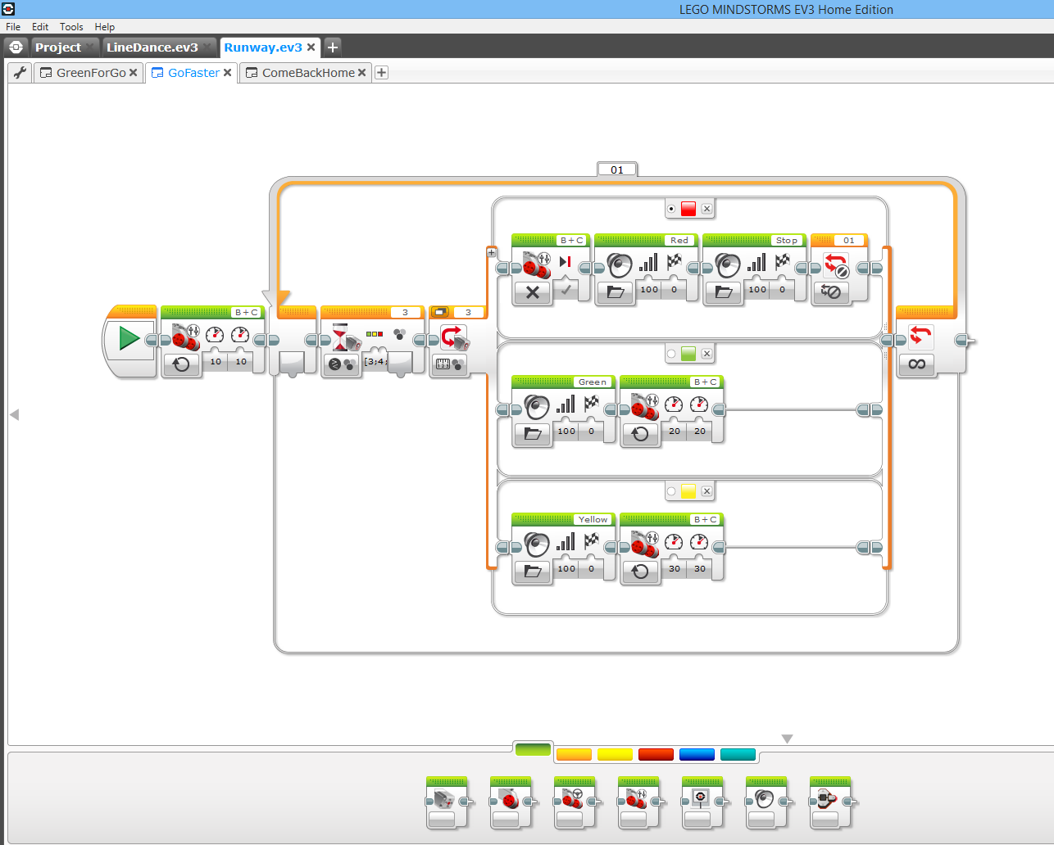
Lego Robot Challenge
The EV3 Language

Slide 7
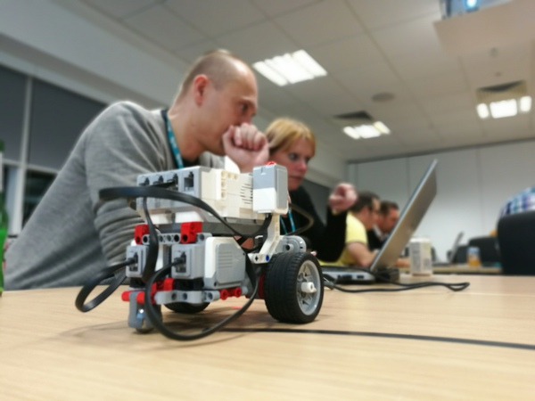
Lego Robot Challenge
Say “hello” to your Lego robot!
Challenge 1 – It’s Alive!
Give your robot eyes, by programming it!
Challenge 2 – Hello Bot!
Make your robot say “Hello”.
Challenge 3 – We have control!
Make your robot blink and say “Hello” when you press the touch sensor.

Slide 8
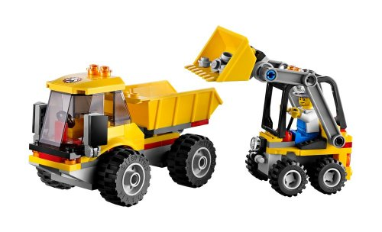
Lego Robot Challenge
On the move
Challenge 4 – Going forwards
Make your robot go forwards for 4 seconds, stop, and say “stop”.
Challenge 5 – Dumper Truck
Make your robot go forward for 4 secs, stop, and say “stop”. Then reverse for 3 secs with flashing lights.
Mechanical \ Backing Alert

Slide 9

Lego Robot Challenge
Challenge 6 – Everything is awesome!
Put everything that you’ve learnt so far together.
Build a robot that is capable of acting as a self driving car.
Your robot must;
Drive itself along a road (represented by a black line).
Have a crash-detect system so that it doesn’t crash into another car (robot).

Slide 10
Lego Robot Challenge
Challenge 6 – Everything is awesome! – Part 1
Drive your robot along a road (represented by a black line).
Hint 1:
Use the colour sensor to detect light and dark.
Hint 2:
Move each wheel separately to keep your robot on track.

Slide 11
Lego Robot Challenge
Challenge 6 – Everything is awesome! – Part 2
Design a crash-detect system so that your robot doesn’t crash into another robot.
Hint:
Use the proximity sensor to detect objects that are in front of your robot.

Slide 12
Lego Robot Challenge
One last thing … How would you know it’s safe to cross?

Slide 13
